Slide 1

Azure Function App

Slide 2
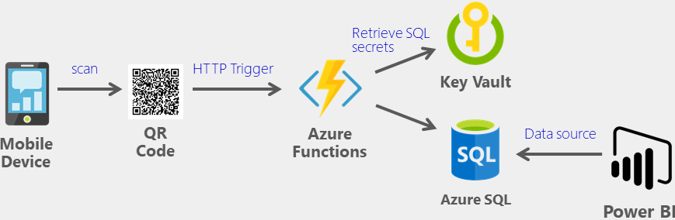
What are Function Apps and its usage
Can author and execute snippets of code in the cloud
No hassle of managing the servers
It lets you run small pieces of code
Doesn’t have to worry about the infrastructure of the platform
Notes:
https://microsoft-bitools.blogspot.com/2020/02/use-azure-key-vault-for-azure-data.html

Slide 3

Supported Languages
C#
F#
JavaScript
Java 8
PowerShell Core 6
Python 3.7.x
Typescript

Slide 4
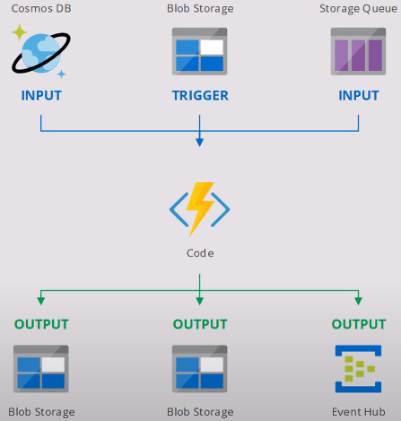
How Azure Functions Works

Slide 5
Azure Function: Hands-on
Create a Function in Azure Function App

Slide 6
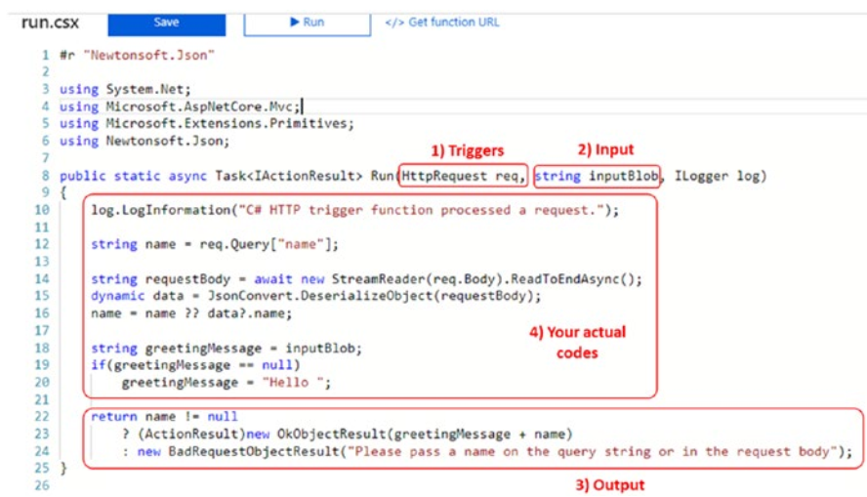
Example of function

Slide 7
Triggers: Hands-on

Slide 8
Azure Durable Functions
An extension of Azure Function that is used to write Stateful Functions
It consists of Orchestrator function and entity functions that can be defined as a workflow
As a state-based services, it enables checkpoint and restarts from it.
Azure Durable Function supports languages like
C#
JavaScript
F#
Python
PowerShell

Slide 9
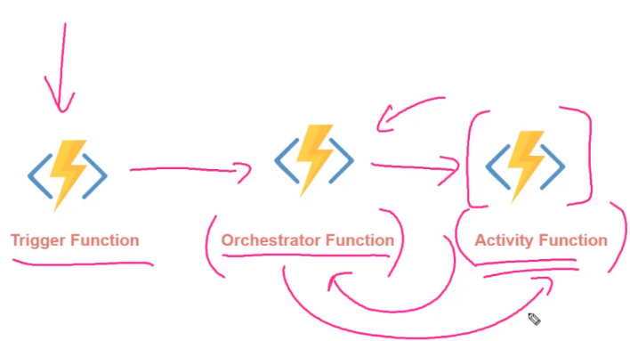
Azure Durable Functions

Slide 10
Azure Durable Functions - Example
In this example, the values F1, F2, F3, and F4 are the names of other functions in the same function app.
import azure.functions as func
import azure.durable_functions as df
def orchestrator_function(context: df.DurableOrchestrationContext):
x = yield context.call_activity("F1", None)
y = yield context.call_activity("F2", x)
z = yield context.call_activity("F3", y)
result = yield context.call_activity("F4", z)
return result
main = df.Orchestrator.create(orchestrator_function)

Slide 11
Durable Function: Hands-on
Create a Durable Function

Slide 12
What are Kudu in Function App
The advanced tools for App Service (also known as Kudu)
Provide access to advanced administrative features of your function app.
From Kudu, you manage
System information,
App settings,
Environment variables,
Site extensions,
HTTP headers, and
server variables.
Accessing your KUDU console is easily done via the following URL: https://dotest.scm.azurewebsites.net
Replace dotest with the name of your app name

Slide 13
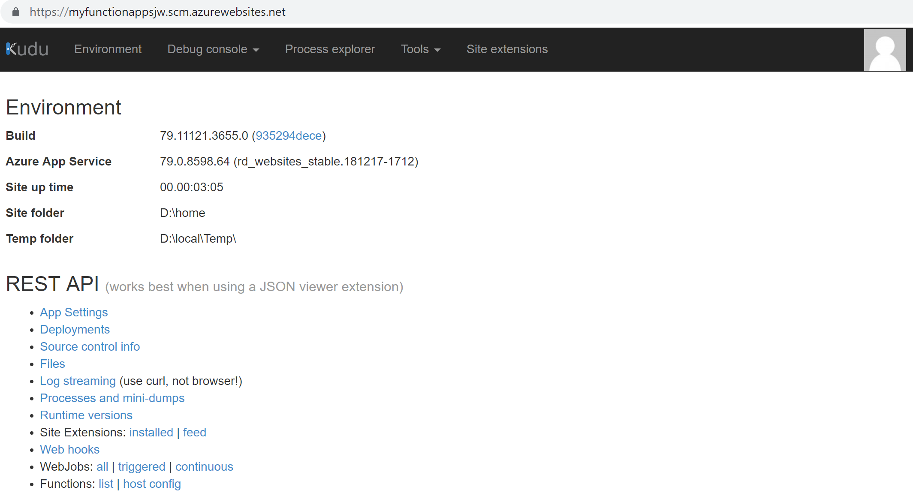
What are Kudu in Function App

Slide 14


